Slide 1
A Student Exploration of the Impacts of Climate Change on Human Health in the United States
John Balbus, MD, MPH
Senior Advisor for Public Health
National Institute of Environmental Health Sciences
NOAA/MADE CLEAR Climate Change Academy
Towson, Maryland
August 9, 2017

Slide 2
The mission of the National Institute of Environmental Health Sciences is to discover how the environment affects people in order to promote healthier lives
The National Institute of Environmental Health Sciences
Notes:
We at NIEHS are one of 27 institutes and centers of the National Institutes of Health, the only one not headquartered at the Bethesda, MD campus. Our campus and headquarters is located in Research Triangle Park, North Carolina. Most of you know us, but for those who don’t, who are new to toxicology and environmental health, let me get you acquainted with our Institute, so you can see what we bring to today’s discussion on public health and chemical exposure.
We are the premier environmental health sciences research institution in the world, comprising intramural laboratories and extramural funding programs. Like most of our sister institutes, the greatest share of our funding goes to support our extramural research and training activities in universities and research institutions across the nation, under the administration of our Division of Extramural Research and Training.
We also provide the headquarters and leadership, and most of the funding, for the National Toxicology Program.

Slide 3
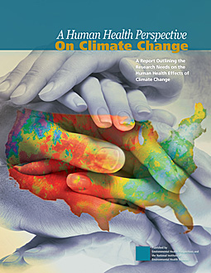
Some Background
2010: A Human Health Perspective on Climate Change
NIEHS Environmental Health Perspectives journal staff created K-12 educational module
Partnership with UNM

Slide 4
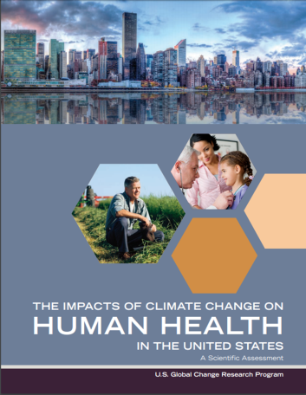
The new USGCRP Climate Health Assessment
Released April 2016
https://health2016.globalchange.gov/
Demonstrates advances in knowledge and levels of confidence
NIEHS partnerships with AMS and NOAA led to decision to update materials with UNC

Slide 5
GCRP Climate Health Assessment: Top Line Messages
Climate change is a significant threat to the health of the American people.
Climate change exacerbates some existing health threats and creates new public health challenges.
This assessment significantly advances what we know about the impacts of climate change on public health, and the confidence with which we know it.
Every American is vulnerable to the health impacts associated with climate change.

Slide 6
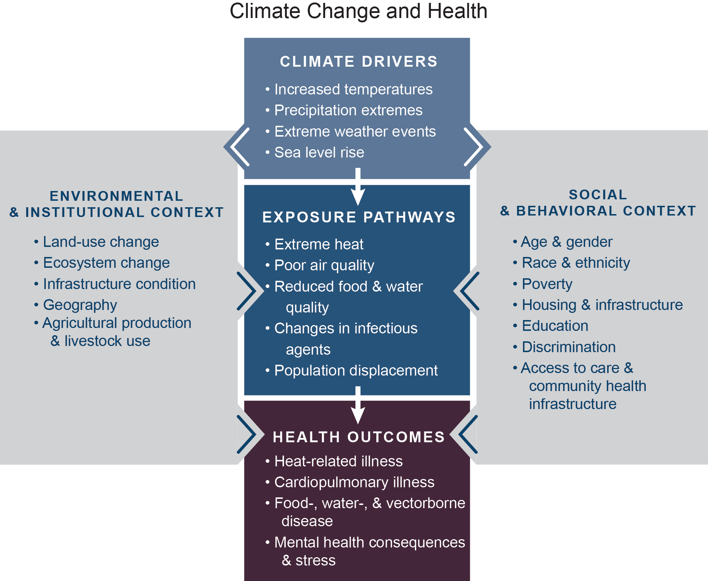
Climate change affects human health in two main ways:
Changing the severity or frequency of health problems that are already affected by climate or weather factors
Creating unprecedented or unanticipated health problems or health threats in places where they have not previously occurred.
Climate and Health Assessment, 2016
Notes:
Examples:
1) Areas already experiencing health-threatening weather and climate phenomena, such as severe heat or hurricanes, are likely to experience worsening impacts.
2) Areas previously unaffected by toxic algal blooms because of cooler water temperatures may face these hazards in the future as temperatures increase, allowing the organisms to now thrive in the region.
A useful approach to understanding how climate change affects health is to consider specific exposure pathways and how they can lead to human disease.
These exposure pathways can vary over time and in different locations.
Everyone will be affected, but the impacts will vary by different people and communities by different degrees depending on vulnerability (which will be discussed in more detail later)
There are both individual (right box) and larger level (left box) that influence vulnerability.
While often considered individually, it is important to note that multiple climate stressors can occur simultaneously resulting in compounding or cascading impacts.

Slide 7
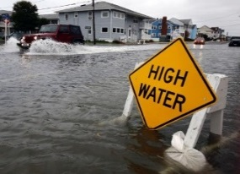
Significant Findings
Quantifies future increases in temperature-related deaths
Confirms air quality impacts and provides likelihood for ozone, wildfire impacts
Connects changes in extreme events to increased exposure to health impacts
Notes:
Quantifies future increases in temperature-related deaths
Confirms very high confidence in association between hotter- and colder-than-normal temperature and increased illness and death
Quantifies the increase of thousands to tens of thousands of premature heat-related deaths projected in the summer due to climate change
Assesses the impact of changes in tolerance to extreme heat on future deaths from heat
Confirms air quality impacts and provides likelihood for ozone, wildfire impacts
Provides new likelihood assessment (likely) and high confidence that climate change will make it harder to reduce ground-level ozone pollution, and that increased wildfires increase health risks
Confirms high confidence that increases in airborne allergens will worsen allergy and asthma conditions and confirms indoor air health risks as significant emerging area
Connects changes in extreme events to increased exposure to health impacts
Identifies health impacts, including death, injury, or illness; exacerbation of underlying medical conditions; and adverse effects on mental health (high confidence)
Describes impacts to health from disruption of essential infrastructure
High confidence that coastal flooding will impact vulnerable communities

Slide 8
Significant Findings
Provides likelihood of changing vector distribution, expands discussion of WNV
Details sources and pathways (drinking, recreational) of waterborne illness risk
First assessment of rising CO₂, climate on quality (nutritional value) of food
Notes:
Provides likelihood of changing vector distribution, expands discussion of WNV
Likely, high confidence in changing geographic and seasonal distribution of ticks carrying Lyme, and likely, medium confidence in increases in risk to human exposure
Assessment of impacts of West Nile virus show very likely, high confidence in climate change influence on distribution, abundance, and prevalence of infection in mosquitoes
Details sources and pathways (drinking, recreational) of waterborne illness risk
Disaggregates confidence and likelihood for changes in multiple water-related illnesses from Vibrio bacteria, marine harmful algae, freshwater harmful algae, and runoff sources
Describes health impacts of water infrastructure damage or failures
First assessment of rising CO₂, climate on quality (nutritional value) of food
Describes impacts of pathogens, toxins, and chemical contaminants in US food chain
Assesses the large body of research establishing very likely, high confidence that nutritional value of food crops, such as wheat and rice, will decrease as rising levels of atmospheric CO₂ reduce concentrations of protein and essential minerals in most species

Slide 9
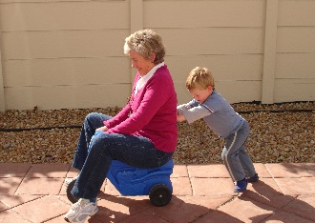
Significant Findings
Presents an important emerging area: increased mental health consequences
Details the ways in which climate change affects the health of us all
Notes:
Presents an important emerging area: increased mental health consequences
Confirms Very High Confidence in extreme weather and climate related impacts including post-traumatic stress disorder (PTSD), depression, and anxiety, often at the same time
Introduces mental health impacts from real and perceived threats of climate change; risks of heat exposure to people with pre-existing mental health illnesses or prescription medications
Details the ways in which climate change affects the health of us all
People experience different inherent sensitivities to the impacts of climate change at different ages and life stages. For example, the findings confirm with very high confidence the very young and old are particularly sensitive to climate-related health impacts.

Slide 10
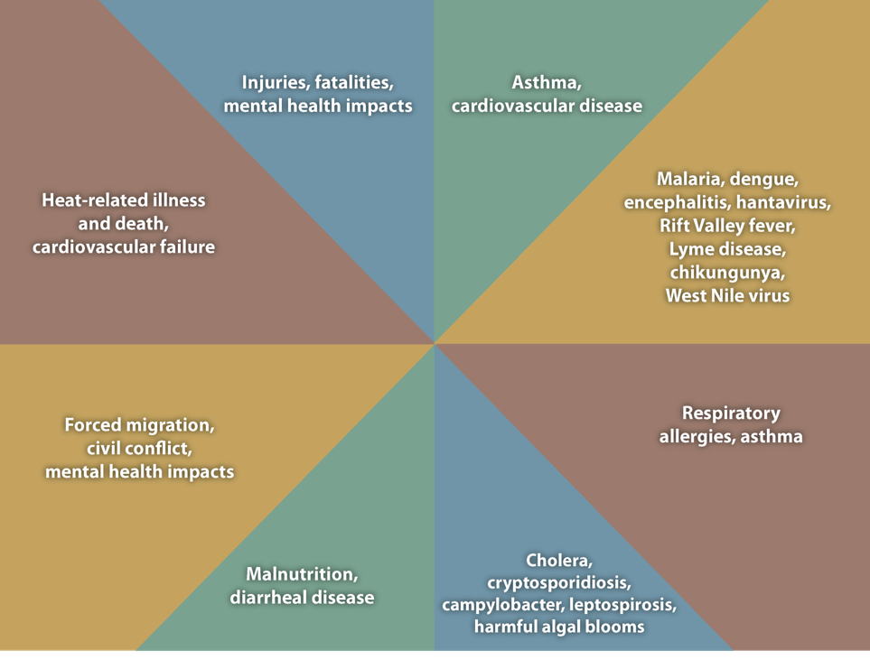
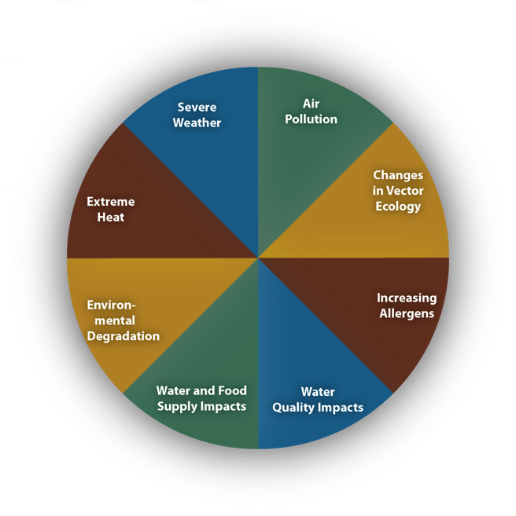
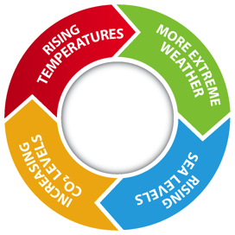
Slide courtesy of Dr. George Luber, CDC
Notes:
I’d like to spend a few minutes going into some more detail on the impacts side of climate change for human health. Impacts are place based and path dependent. Focus on exposure pathways.

Slide 11
http://www.niehs.nih.gov/lessonsinclimatechange

Slide 12
Acknowledgements
Dana Brown Haine, MS, University of North Carolina
The following experienced science educators reviewed the 2016 module and/or enabled the piloting of the module with students:
Joshua Abernethy, Wake Young Men's Leadership Academy, Raleigh, North Carolina
Jessica Croson, Heide Trask Senior High School, Burgaw, North Carolina
Jenna Hartley, Environmental Health Fellow, US EPA
Emma Refvem, Riverside High School, Durham, North Carolina
Erin Shindledecker & Steven Snyder, East Chapel Hill High School, Chapel Hill, North Carolina

Slide 13
How can incorporating health add value when teaching climate change?
Connects more abstract earth science to personal concerns
Provides opportunities to tie together different topics (climate, air pollution, hydrology)
Offers interesting data applications
Raises awareness in a vulnerable and critical population
Notes:
Image courtesy of NOAA.gov

Slide 14
Spreading the word…
NIEHS has asked MDB, Inc. to convene an informal consortium of climate/earth science educators to assist with outreach and dissemination
NOAA, AMS, CLEAN, Green Schools Nat’l Network, etc.
Partnership with GLOBE to add application of earth observations to their protocols
Submission to NGSS and CLEAN network for vetting and inclusion in their resources
Partnership with AMS and DataStreme program

Slide 15
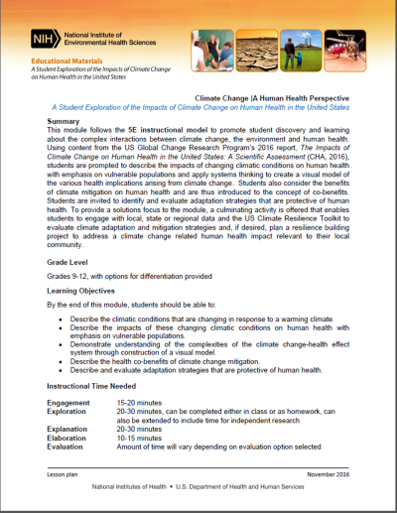
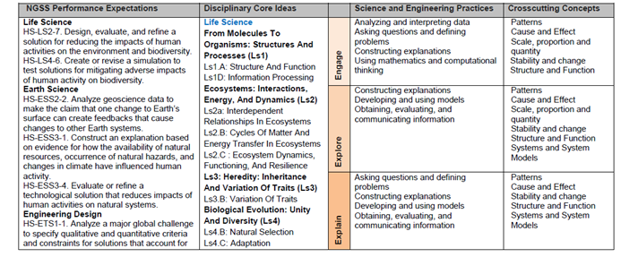
Basics
Target audience: Grades 9-12 students
Easily adaptable for other grades, higher education and informal educational settings
Time: 1-3 hours
Materials:
Teacher presentation slides
Differentiated reading materials
Worksheets and answer key
Students should be introduced to the general concept of climate change and to the human activities influencing climate through greenhouse gas emissions prior to conducting this module.
This module is appropriate for both earth and life science courses and can be used to either introduce or reinforce the specific climatic changes that are occurring in response to warming.

Slide 16
Framework and Standards Alignment
This module addresses principles of climate science outlined in Climate Literacy: The Essential Principles of Climate Science
This module utilizes the 5E instructional model
The module integrates multiple science and engineering practices, disciplinary core ideas, and cross cutting concepts for earth and life sciences. It was designed with Next Generation Science Standards in mind.

Slide 17
Learning Objectives
Describe the impacts of changing climatic conditions on human health
Consider the benefits of climate mitigation on human health
Identify and evaluate adaptation strategies that are protective of human health.
Engage with local, state or regional data and the US Climate Resilience Toolkit to evaluate climate adaptation and mitigation strategies

Slide 18
Visual Model | Cause-effect

Slide 19
Flooding
Some individuals and groups may be more vulnerable to water-borne infection as a result of floodwaters.
Notes:
Image credit: https://s3.amazonaws.com/climatehealth2016/low/ClimateHealth2016_04_Extremes_small.pdf

Slide 20
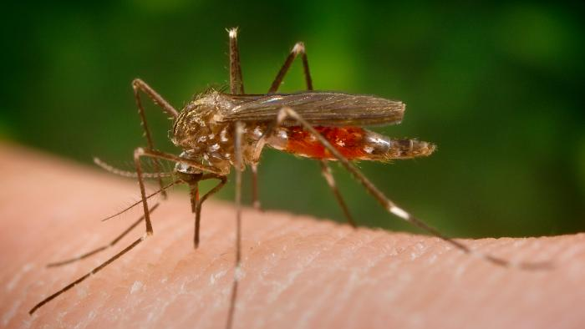
Vector Borne Disease
Increased Temperature & Precipitation Changes
Moisture, Temperature, Breeding Sites
Vector Populations & Pathogen Reproduction
Vector Borne Diseases
Notes:
Image credit: CDC/Frank Collins
The Aedes japonicus Notre Dame colony was established from specimens collected as larvae in water filled containers (flower pots and tires) in residential areas of South Bend, Indiana in the summer of 2005. This mosquito is suspected of being a vector of the Japanese Encephalitis virus in Asia and the West Nile in the United States. While Aedes japonicus has not been incriminated as a major vector of West Nile virus in the United States, it is nevertheless of concern to public health agencies because of its fairly rapid colonization of a large part of the north eastern and midwestern United States and its propensity to lay eggs in flooded containers found around human dwellings.

Slide 21
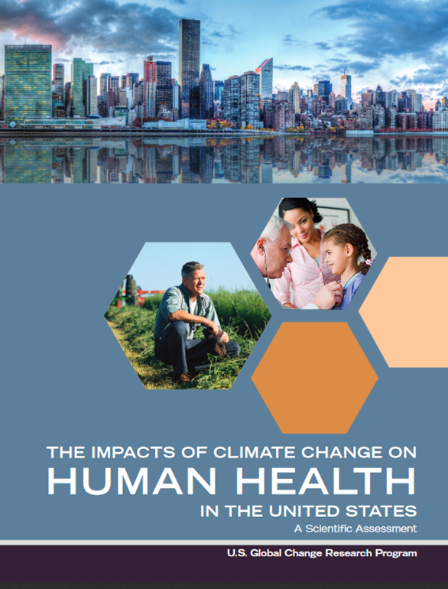
Directions
READ your assigned impact section:
Group 1 – Temperature-related impacts (chapter 2)
Group 2 – Air Quality impacts (chapter 3)
Group 3 – Impacts from extreme events (chapter 4)
Group 4 – Vector-borne disease impacts (chapter 5)
Group 5 – Water-related impacts (chapter 6)
Group 6 – Impacts to food (chapter 7)
Group 7 – Impacts to mental health (chapter 8)

Slide 22
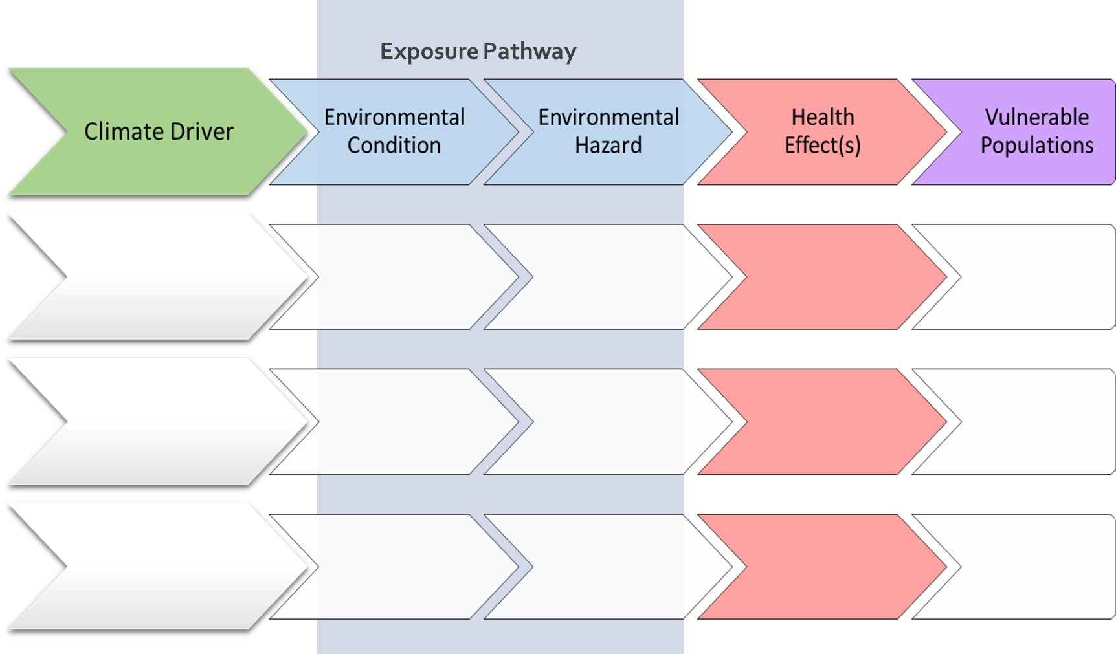
Notes:
PPT of student graphic organizer; students may not be able to complete all rows.

Slide 23
Climate Driver
Exposure pathway
Health Outcomes
Increased AIR temperatures
Environmental Condition
Hazard
Decreased AIR temperatures
Changing Temperature
Increased WATER temperatures
Increased mold
Asthma & Allergies
Decreased WATER temperatures
High waters
Increase in nutrient runoff
Water-related Infection
Increased precipitation
Flooding
Changing Precipitation
Drowning & Injury
Decreased precipitation
Disruptions to infrastructure
Contaminated water
Food-related Infection
Extreme weather events
Changing weather patterns
One environmental condition can lead to multiple health outcomes
Changes in cloud cover, humidity, winds
Stress-related disorders
Notes:
One environmental condition can lead to multiple health outcomes

Slide 24
Exposure pathway
Health Outcomes
Prolonged exposure to heat
Climate Driver
Heat-related illness and death
Elevated air temperature
Increased ground-level ozone
Increased AIR temperatures
Longer growing season
Increased particulate matter
Cardiovascular illness & death
Increased WATER temperatures
Changing Temperature
Elevated water temperature
Increase in mold
Asthma & Allergies; respiratory illness
Earlier spring
Increase in nutrient runoff
Water-related Infection
Increased precipitation
Flooding
High waters
Drowning & Injury
Changing Precipitation
Decreased precipitation
Increased dust
Drought
Vector-borne Infection
Increased pollen
Wildfires & smoke
Disruptions to infrastructure
Food-related Infection
Extreme weather events
Hurricanes and storms
Changing weather patterns
Expanded tick activity
Stress-related disorders
Increased growth of pathogens

Slide 25
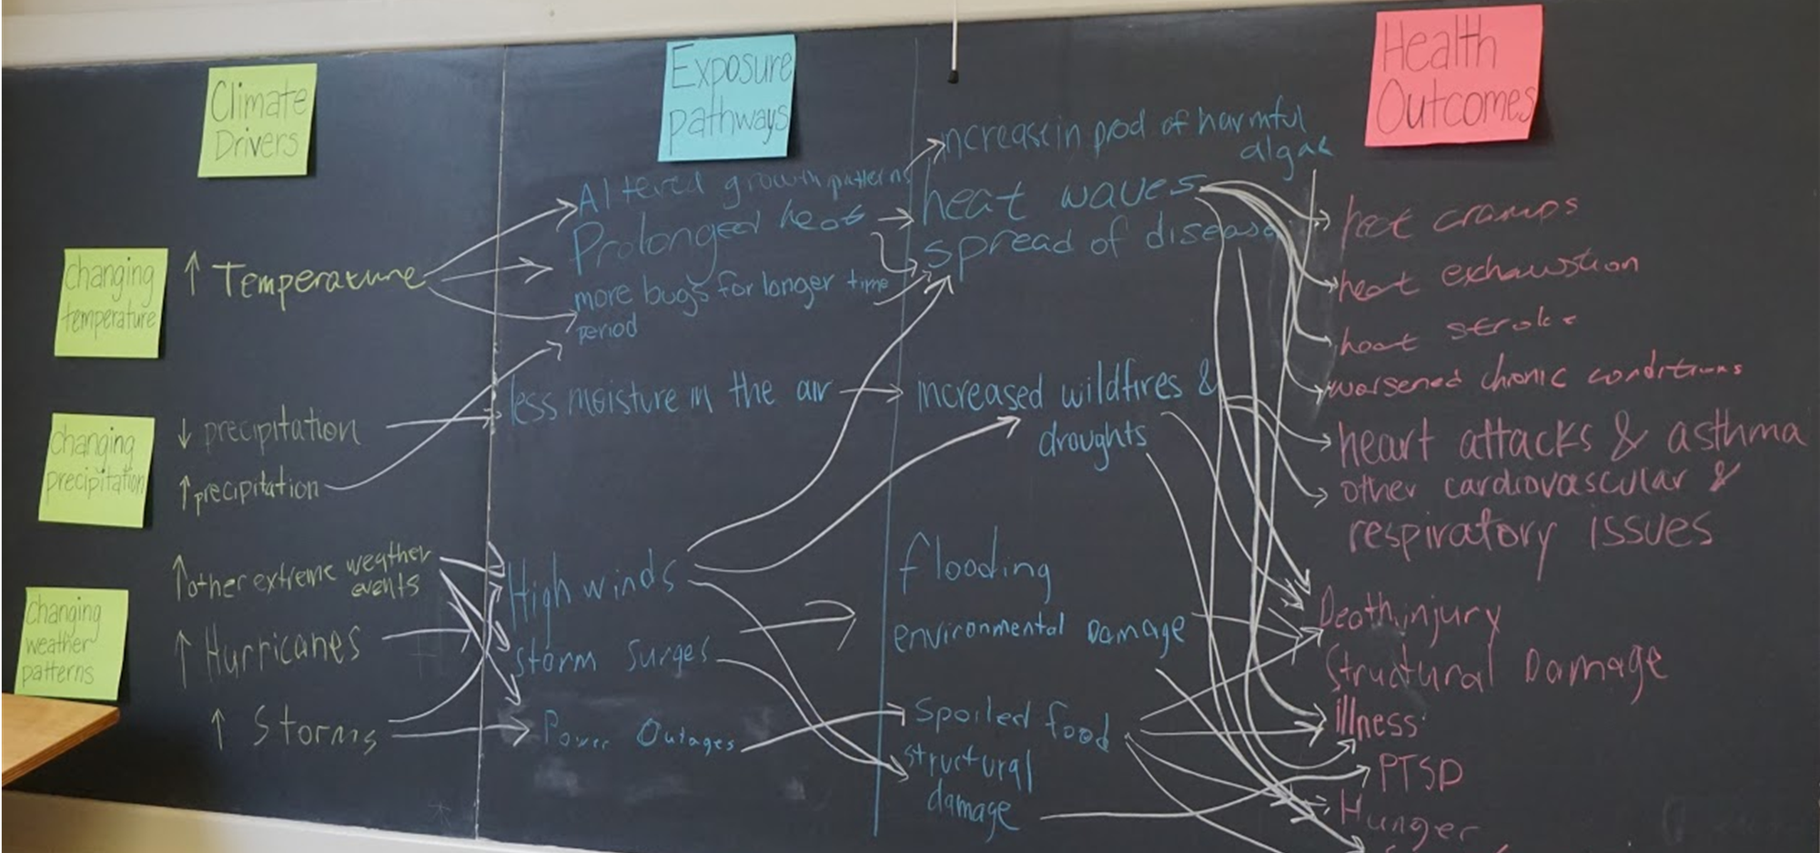
Notes:
This lesson promotes systems thinking necessary to understand how climate change impacts human health.

Slide 26
The 5 “E’s”
Engagement-opening presentation- assess pre-existing knowledge- 20 minutes
Exploration- student exercise- 20-30 minutes
Explanation- discussion of exercise; demonstration of systems approach; 30 minutes
Elaboration- introduction of mitigation and adaptation concepts- 10-15 minutes
Evaluation- depends on option chosen
Brief written assignment on co-benefits or adaptation
More thorough review of co-benefits or adaptation options
Challenge students to design local interventionN

Slide 27
Climate Actions and Health
Mitigation-reduce or remove emissions of greenhouse gases
Clear health benefits of fossil fuel reductions; energy
Green jobs and equity
Linkages to animal agriculture, urban design and transportation
Adaptation- prevent or lessen health impacts from climate change
Some measures are also mitigation- urban heat island reduction, building insulation, land use change
Public health strengthening- issues of social justice

Slide 28
Find the Materials
Free Copies of the Materials http://www.niehs.nih.gov/lessonsinclimatechange
Program Homepage
www.niehs.nih.gov/geh
Questions?
NIEHSGEH@mail.nih.gov

Slide 29
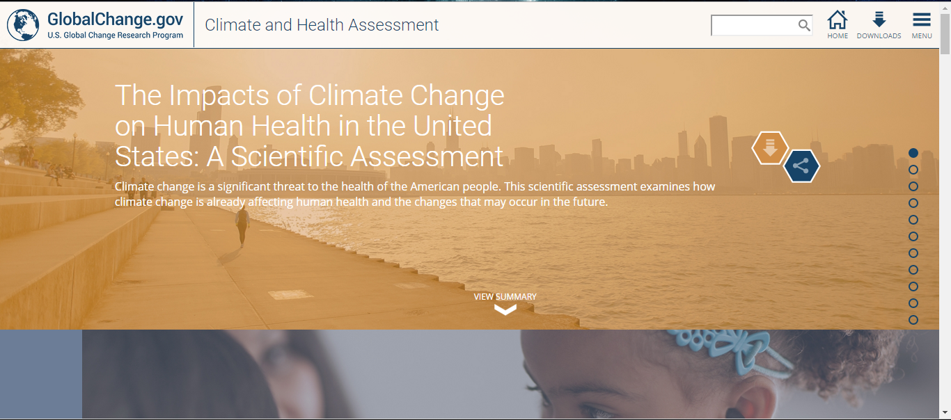
Resources: health2016.globalchange.gov
Quick links to downloads and chapters

Slide 30
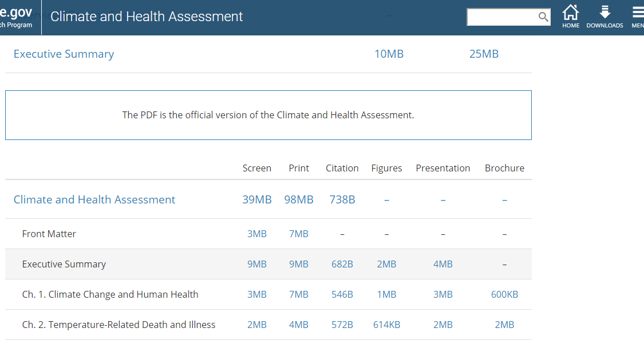
Resources: health2016.globalchange.gov
Download page has report, chapters, citations, figures, PowerPoint presentations, and 2-pg summaries
Spanish translated Executive Summary also available

Slide 31
Thank you for your attention!
http://www.niehs.nih.gov/lessonsinclimatechange
John Balbus, MD, MPH
John.balbus@nih.gov
www.niehs.nih.gov/geh

