Slide 1
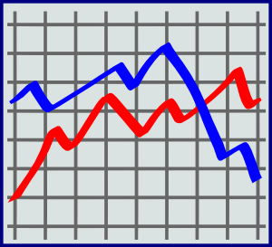
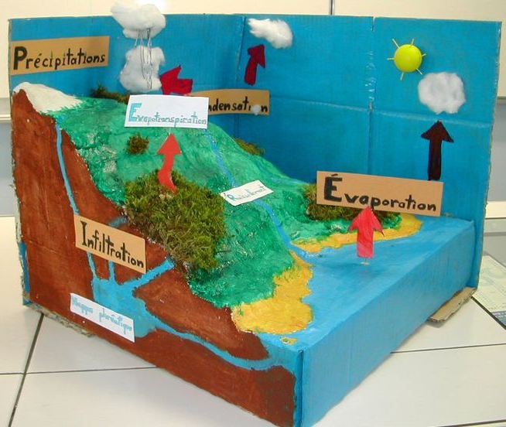
Analyzing and Interpreting Data
Asking Questions and Defining Problems
?
?
Scientific investigations produce data that must be analyzed in order to derive meaning. Because data patterns and trends are not always obvious, scientists use a range of tools—including tabulation, graphical interpretation, visualization, and statistical analysis—to identify the significant features and patterns in the data. Scientists identify sources of error in the investigations and calculate the degree of certainty in the results. Modern technology makes the collection of large data sets much easier, providing secondary sources for analysis.
A practice of science is to ask and refine questions that lead to descriptions and explanations of how the natural and designed world works and which can be empirically tested.
Developing and Using Models
Using Mathematics and Computational Thinking
A practice of both science and engineering is to use and construct models as helpful tools for representing ideas and explanations. These tools include diagrams, drawings, physical replicas, mathematical representations, analogies, and computer simulations.
In both science and engineering, mathematics and computation are fundamental tools for representing physical variables and their relationships. They are used for a range of tasks such as constructing simulations; statistically analyzing data; and recognizing, expressing, and applying quantitative relationships.
Planning and Carrying Out Investigations
Constructing Explanations and Designing Solutions
Scientists and engineers plan and carry out investigations in the field or laboratory, working collaboratively as well as individually. Their investigations are systematic and require clarifying what counts as data and identifying variables or parameters.
The products of science are explanations and the products of engineering are solutions.

