Slide 1
Isotopes, Ice Cores and Climate Change
Laura Marschke
Southwest Early College

Slide 2
Overview
What are we learning about today?
What is an isotope?
What are isotopes used for?
“Behind the scenes” of ice cores
The science of ice cores and isotopes
What do isotopes have to do with ice cores?
What do we know about climate from oxygen isotopes?

Slide 3
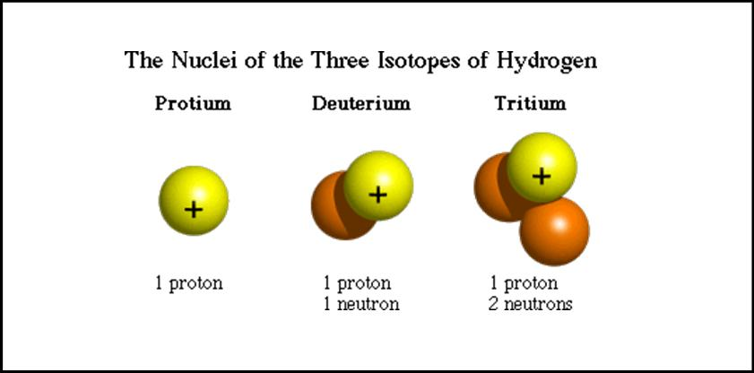
What is an isotope?
Isotope: Atoms with the same number of protons but different numbers on neutrons
Example 1 Hydrogen

Slide 4
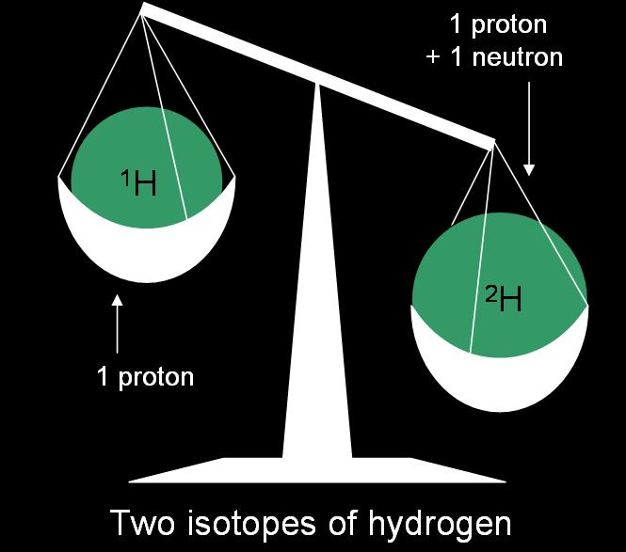
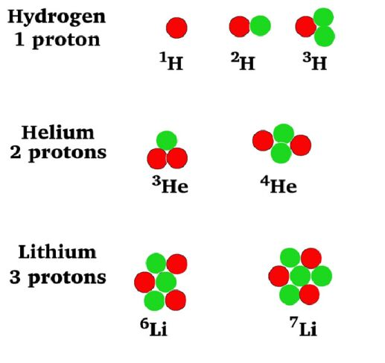
Examples 1-3

Slide 5
Example 4 - Carbon
How many protons does each isotope have?
How many neutrons does each isotope have?
Stable vs unstable

Slide 6
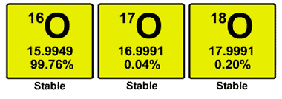
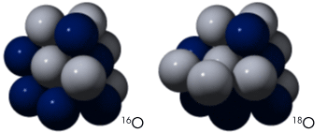
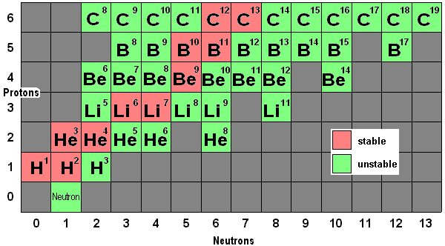
Example 5 - Oxygen
Oxygen has three stable isotopes (and 17 unstable)
We care most about ¹⁶O and ¹⁸O and you will visit them again later in this presentation
Most elements have many isotopes
Here is a portion of the periodic table showing how many isotopes each element has

Slide 7
What are isotopes used for?
Radiocarbon dating
Medical uses
Nuclear power
Miscellaneous uses
Paleoclimate proxy

Slide 8
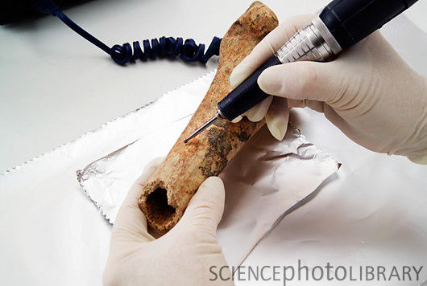
Radiocarbon Dating
Determining the ages of old things
Carbon-14 is a radioactive isotope of carbon found in all living things
It decays at a steady rate, so we can determine the age of things that lived between 2000-50,000 years ago
Sample being removed from bone for carbon dating

Slide 9
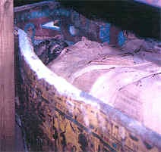
Radiocarbon Dating
One famous use of ¹⁴C dating is the dating of Egyptian mummies
The picture is a mummy from the Niagara Museum in Georgia
990-960 BCE

Slide 10
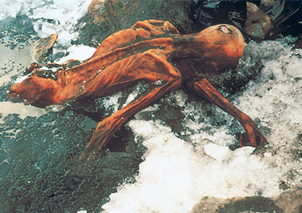
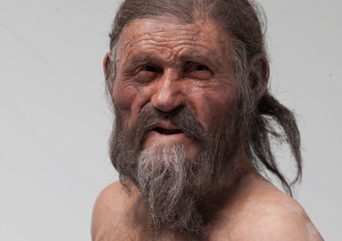
Radiocarbon Dating Ötzi the Iceman
Undisputable proof of the authenticity and extraordinary age of the Iceman and his possessions was provided by C-14 analysis
Four different scientific institutions analyzed tissue samples from the corpse and the finds. The results were unequivocal: the Iceman lived between 3350 and 3100 BC
“Only the back of the head, the bare shoulders and part of his back jutted out of the ice and melt water. The corpse lay with its chest against a flat rock and its face obscured. Beside the corpse the two hikers noticed several pieces of rolled-up birch bark. Before leaving the scene, they took a photograph of what they thought to be the unfortunate victim of a mountaineering accident a few years back.”

Slide 11
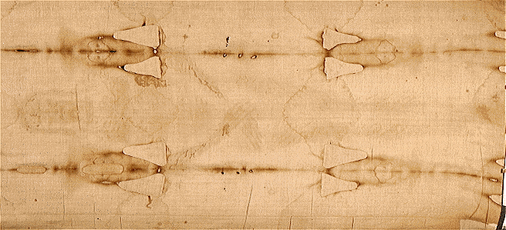
Radiocarbon Dating Shroud of Turin
Another famous case that involved ¹⁴C dating was the Shroud of Turin, a cloth that some claim to be the burial cloth of Christ
Results:
CE 1273-1288 with 68% confidence
CE 1262-1384 with 95% confidence
There are a LOT of controversies surrounding this information!!!

Slide 12
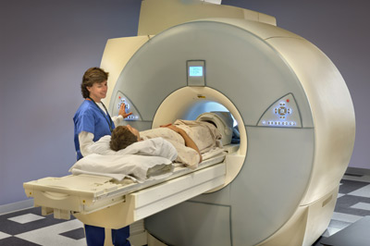
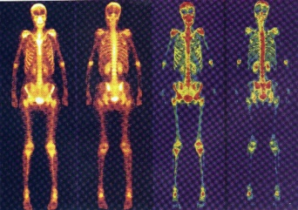
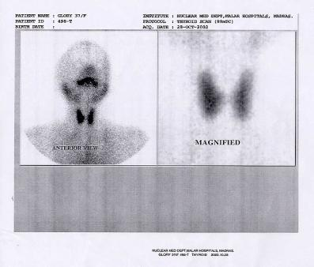
Medical Uses
Tracers
²⁴Na
Diagnosing circulatory problems
⁹⁹Tc
Diagnosing brain, heart and organ problems
¹³¹I
Diagnosing thyroid problems
⁶⁰Co
Produces a beam of radiation that is used in killing cancer cells
Cancer treatments using radiotherapy
MRI and CAT scans are both based on nuclear research

Slide 13
Medical Uses, cont.
Positron Emission Tomography (PET)
Scans for positrons emitted by several isotopes, including ¹¹C and ¹⁸F
This particular image shows brain activity of a patient with Parkinson's disease
Parkinson’s disease is a degenerative disorder of the central nervous system

Slide 14
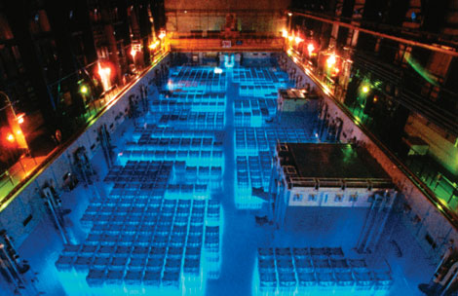
Nuclear Power
The two isotopes most commonly used for nuclear power are ²³⁵U and ²³⁹Pu

Slide 15
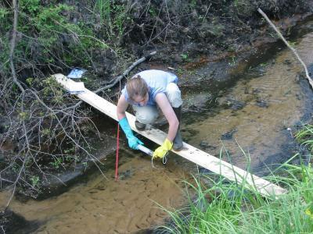
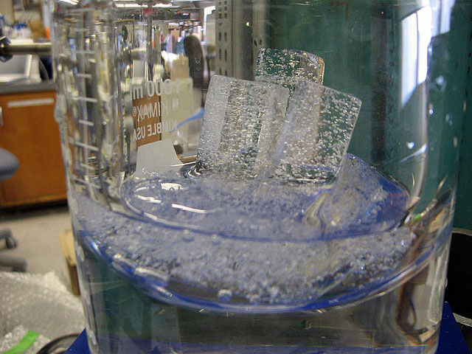
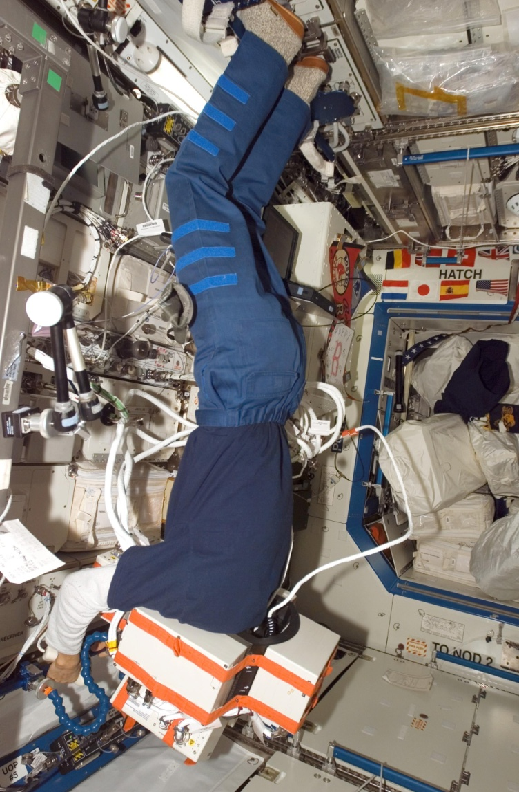
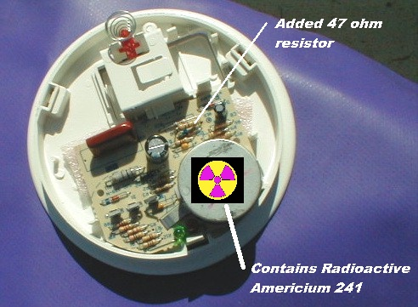
Miscellaneous Uses
Irradiation of food
Used to study how fertilizers and insecticides improve productivity and health of crops and animals
Study potential health risks to astronauts by cosmic radiation
Used to detect pollutants in the environment
Used in smoke detectors
Studying climate from the past

Slide 16
Paleoclimate Proxy
Paleoclimatology – the study of past climates
Proxy – preserved physical characteristics of the past that stand in for direct measurements
Allows scientists to reconstruct past conditions before records were kept
Proxies
Ice cores
Tree rings
Fossilized pollen
Corals
Lake and ocean sediments
Speleothems
Pack rat middens
and others…

Slide 17
Media1
Ice Core - Climate Proxy

Slide 18
Ice Cores – Behind the Scenes
Locations and drilling
Process from field to lab

Slide 19
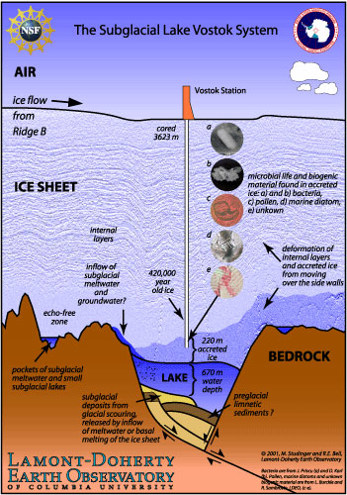
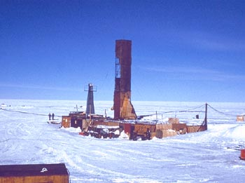
Vostok Station
One of the drill sites in Antarctica
Ice Core - Video

Slide 20
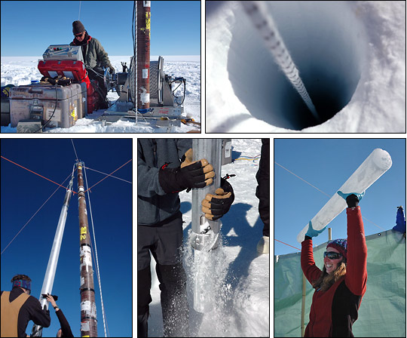
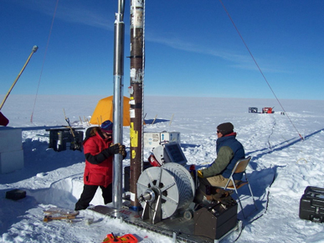
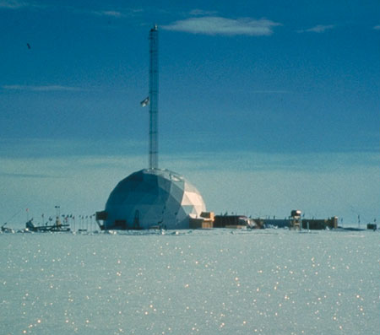
Greenland
The Greenland Ice Sheet Project 2 drill site
Scientists extracted a 100-meter-long ice core in Greenland

Slide 21
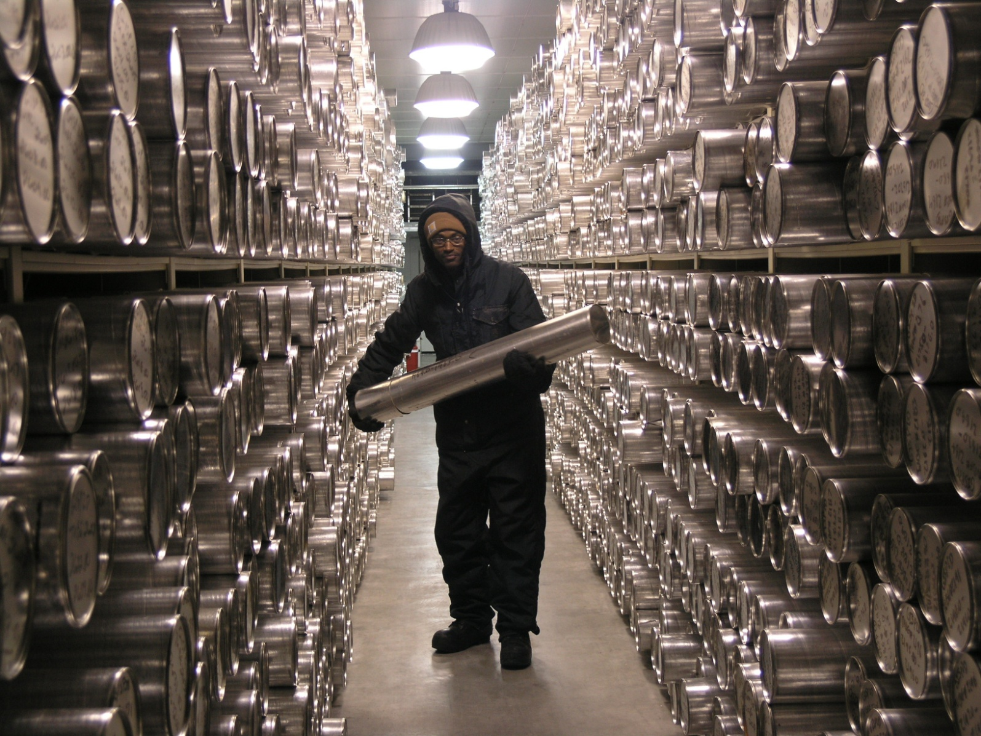
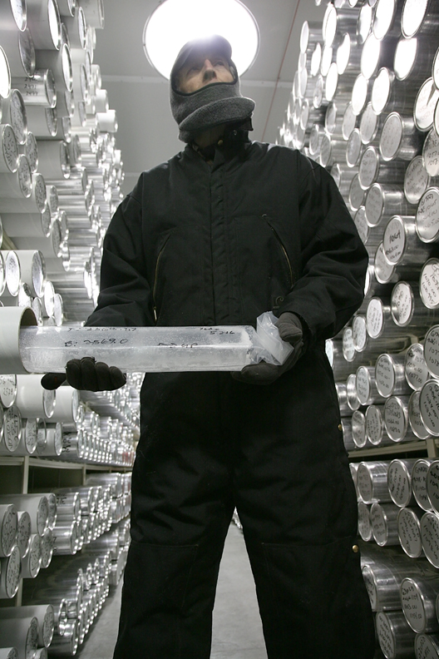
Ice Core Lab
Does anyone know where the National Ice Core Lab is located???
Denver!

Slide 22
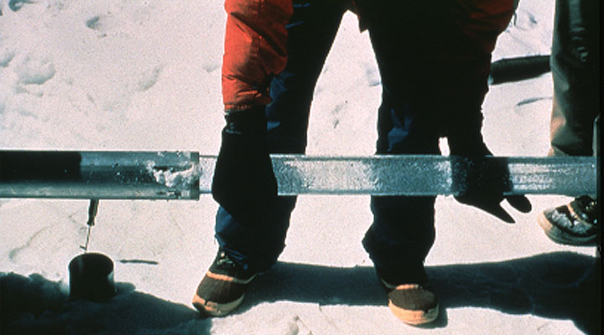
From field to lab
An ice core sample being removed from the drill tube

Slide 23
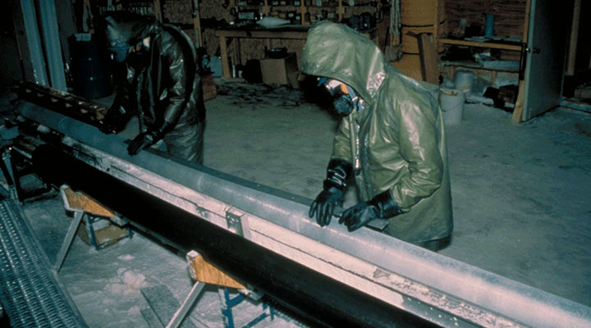
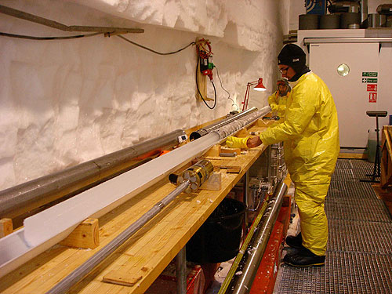
From field to lab
Scientists extrude an ice core from the barrel of a drill tube, taking care not to break the brittle ice
The ice core is cleaned before sawing the ice into 2 meter sections
The cloudy layers visible in this 6 meter core section were formed when dust fell onto the ice sheet and was entrained in the ice

Slide 24
What do isotopes have to do with ice cores?
Ice core basics
Oxygen-18 cycle

Slide 25
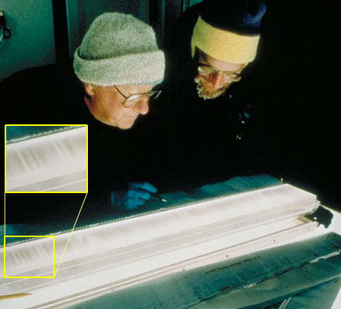
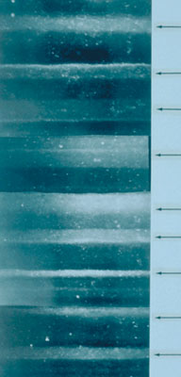
Ice Cores
Scientists examine an ice core sample
Inset shows layering
Close-up view of layers within a different sample
Arrows indicate lighter summer layers

Slide 26
Ice Core Basics
Records of accumulation can be obtained from the thickness of annual ice layers
Impurities in the ice give information about atmospheric circulation and land surface
Known volcanic events help constrain absolute time of ice core data
One of the most distinct ash layers in the Greenland ice cores is seen to the right of this 55 cm long piece of an ice core.
It is a 55,500 year old ash layer, which is believed to originate from an enormous eruption in Iceland.

Slide 27
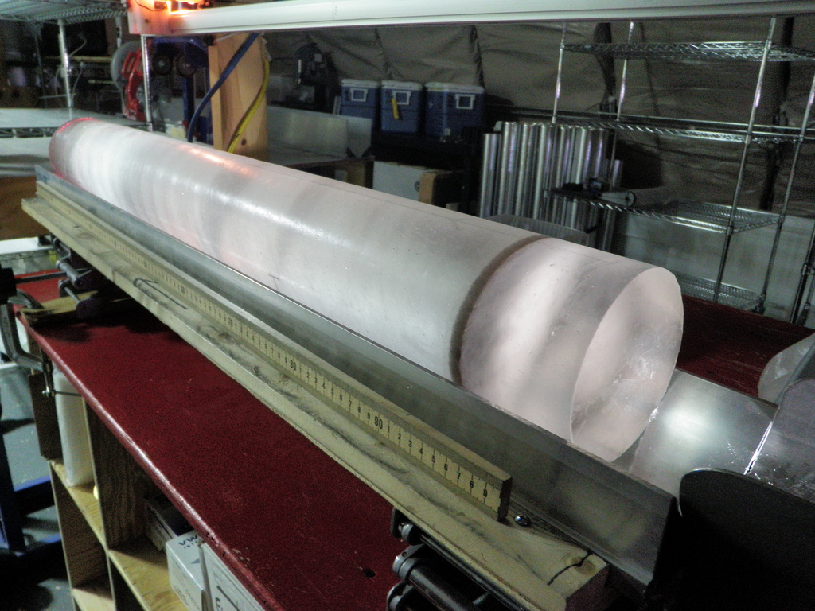
Volcanic Ash Layer
A one-meter long section of ice core with a dark ash layer.

Slide 28
Ice Cores
The gradually increasing weight of overlying layers compresses deeply buried snow into ice, but annual bands remain
Relatively young and shallow snow becomes packed into coarse and granular crystals called firn (top: 53 meters deep)
Older and deeper snow is compacted further (middle: 1,836 meters)
At the bottom of a core (lower: 3,050 meters), rocks, sand, and silt discolor the ice

Slide 29
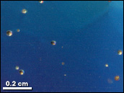
Ice Cores
Air bubbles trapped in the ice cores provide a record of past atmospheric composition
Ice core records prove that current levels of carbon dioxide and methane, both important greenhouse gases, are higher than any previous level in the past 400,000 years

Slide 30
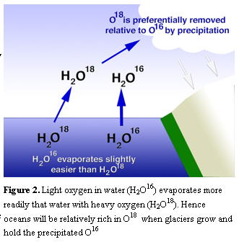
¹⁸O Cycle
Oxygen-18 is heavier than oxygen-16
When it is warm outside, water evaporates
Will more ¹⁸O or more ¹⁶O evaporate?
When it rains or snows, which isotope will be the first to precipitate out?

Slide 31
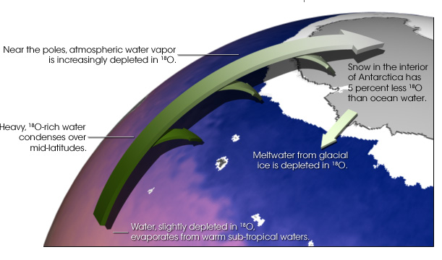
¹⁸O Cycle

Slide 32
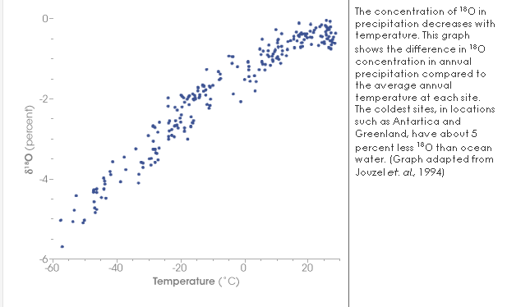
Oxygen-18 vs Temperature

Slide 33
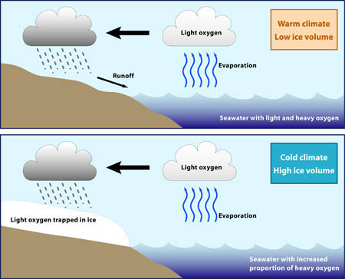
¹⁸O Cycle

Slide 34
Summary of ¹⁸O Cycle
Ice cores contain records of temperature from oxygen isotopes (¹⁸O)
Higher ¹⁸O concentrations, the higher the temperature of condensation of the water vapor that led to the precipitation, and hence the warmer the conditions
Colder times will show fewer ¹⁸O atoms

Slide 35
What do we know about climate from oxygen isotopes?
Vostok record
Paleoclimate reconstruction
Summary
Media

Slide 36
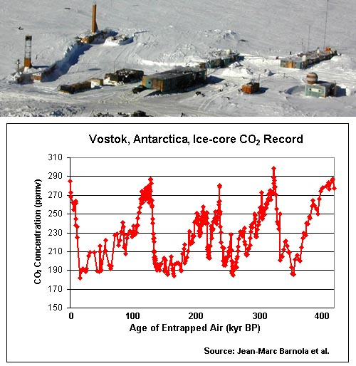
Ice Core Record - Vostok
The Vostok ice core provides the longest continuous record of Antarctic climatic history
Over 400,000 years of climate history

Slide 37
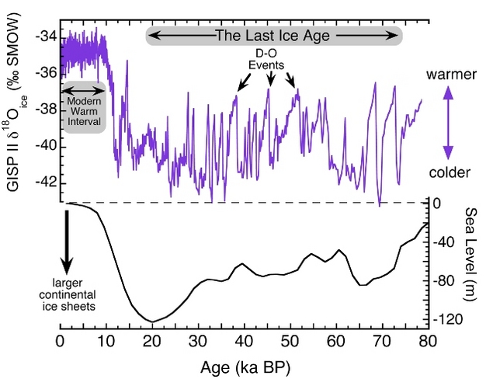
Oxygen-18 over Time
Top panel shows the oxygen isotope record (δ¹⁸O_{ice}) from the Greenland Ice Sheet Project II (GISP II) ice core over the last 80,000 years (Stuiver & Grootes 2000). Colder air temperatures are indicated by more negative δ¹⁸O_{ice} values.
Bottom panel shows changes in global sea level over the same time period (Waelbroeck et al. 2002), reflecting the waxing and waning of continental ice sheets during the last ice age.
Climate variability over the past 80,000 years

Slide 38
Oxygen Isotope and Ice Core Summary
When temperatures are warm, water evaporates into the atmosphere
More ¹⁶O evaporates because it is lighter
Any ¹⁸O is precipitated out as air moves towards the poles
Heavier isotopes will fall out of clouds sooner than lighter isotopes
Glaciers and ice in polar regions will be rich in ¹⁶O and depleted in ¹⁸O
About 5% less ¹⁸O
Comparing ratios of ¹⁶O to ¹⁸O allows scientists to determine warm versus cool periods of past climate
A decrease of one part per million O¹⁸ in ice reflects a 1.5°C drop in air temperature at the time it originally evaporated from the oceans

Slide 39
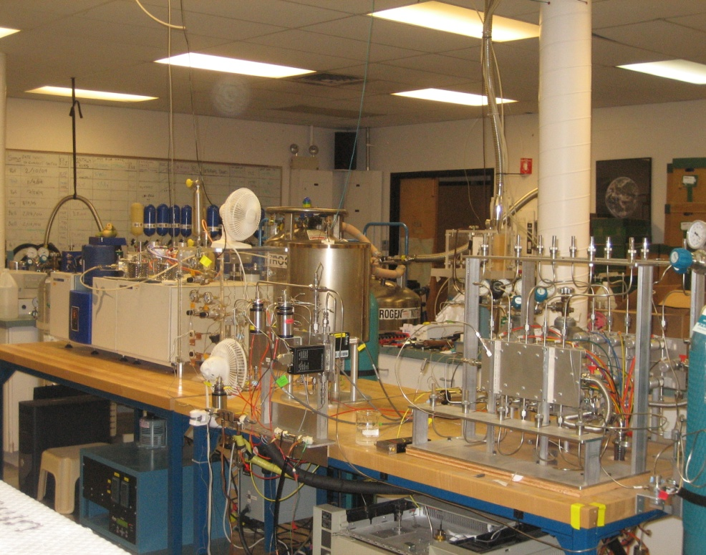
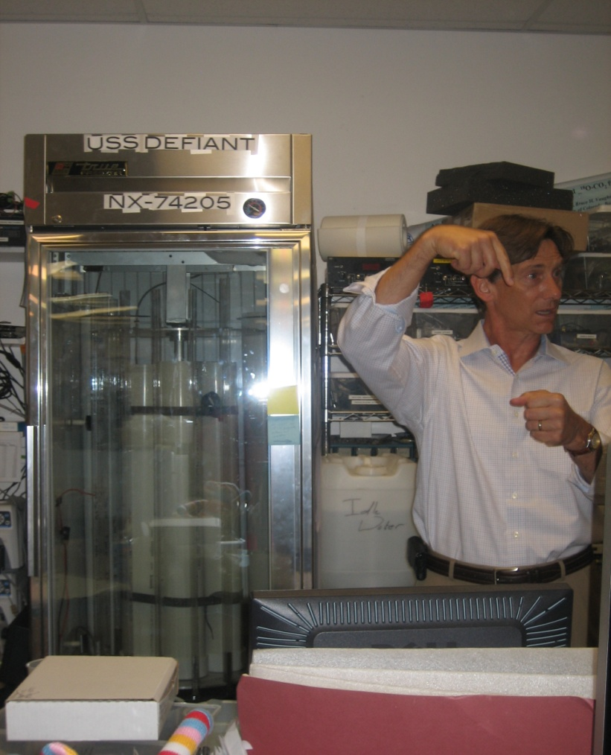
Media 2
Ice Cores - Revealing the Secrets to Global Warming?
Jim White’s INSTAAR Lab – RETI Tour 2012
Jim White explaining the latest and greatest in ice core analysis technology – RETI Tour 2012

Slide 40
Sources
http://www.jinaweb.org/outreach/marble/Marble_Nuclei_Project_-_Teacher_Instructions.pdf
http://en.wikipedia.org/wiki/Radiocarbon_14_dating_of_the_Shroud_of_Turin
http://www.iceman.it/en/oetzi-the-iceman
http://en.wikipedia.org/wiki/Proxy_%28climate%29
http://earthobservatory.nasa.gov/Features/Paleoclimatology_IceCores/
http://www.colorado.edu/geography/class_homepages/geog_4271_f11/lectures/week_11.pdf
http://earthobservatory.nasa.gov/Features/Paleoclimatology_OxygenBalance/
http://www.globalchange.umich.edu/globalchange1/current/lectures/kling/paleoclimate/index.html
http://www.usatoday.com/weather/resources/coldscience/2004-08-30-ice-coreq-a_x.htm
http://www.nasa.gov/mission_pages/station/research/experiments/ALTEA-Shield.html#images
http://www.sciencedaily.com/releases/2008/03/080312141246.htm
http://www.nature.com/scitable/knowledge/library/abrupt-climate-change-during-the-last-ice-24288097
http://en.wikipedia.org/wiki/Isotopes_of_oxygen

Slide 41
Image Sources
http://www.egyptianmuseum.com/mummy1.html
http://eo.ucar.edu/staff/rrussell/climate/paleoclimate/ice_core_proxy_records.html
http://www.nsf.gov/news/special_reports/science_nation/popup/icecores/ice_core.jsp
http://www.futurity.org/tag/ice-core/
http://international.usgs.gov/ipy/images/ppacket/mekuria.ice.core.jpg
http://www.climatedata.info/Proxy/Proxy/icecores.html
http://www.spp-antarktisforschung.de/projects/Martin-Butzin/BU-2243-1-Fig1.jpg
http://www.classzone.com/books/earth_science/terc/content/investigations/es2105/es2105page01.cfm
http://uw-food-irradiation.engr.wisc.edu/materials/food_irradiation/img021.jpg
http://motls.blogspot.com/2006/07/carbon-dioxide-and-temperatures-ice.html
http://www.chemistryland.com/CHM107/GlobalWarming/iceCoreCO2deepest.jpg
http://www.iceandclimate.nbi.ku.dk/research/strat_dating/synch_ice_core_rec/vol_ash_layer/
http://www.flickr.com/photos/ice_drilling/5595529294/
http://coto2.files.wordpress.com/2011/03/3-spent-fuel-rods-in-pool1.jpg
http://www.iranmilitaryforum.net/the-tea-house/debunking-spaceflight/
http://4.bp.blogspot.com/-1iJnG3j5KPY/TbVzPWNUIqI/AAAAAAAADjU/TlAf67AozQE/s1600/smoke_det3.JPG
http://1.bp.blogspot.com/_O0h61kl5hik/TQcfIIKneuI/AAAAAAAAF7U/68oC9Vaq3Ho/s400/18.jpg
http://antarcticsun.usap.gov/AntarcticSun/science/images2/waisdivide_icecore_melting.jpg
http://www.nature.com/scitable/content/ne0000/ne0000/ne0000/ne0000/24290862/resized_1_2.jpg
http://www.noc.soton.ac.uk/gg/IPY/images/isotope_cycle.jpg
http://cascadaecotextiles.files.wordpress.com/2011/09/untitled-4-640-x-419.jpg?w=692
http://mail.rdcrd.ab.ca/~smolesky/Physics30/5Matter/MatterPics/radioisotopes/isotopic%20tracers.jpg
http://www.wcdn.org/SOURCE/india%20report_org.files/image086.jpg
http://static.ddmcdn.com/gif/mri-10.jpg
http://www.ncdc.noaa.gov/paleo/image/collage/paleoproxycollage.jpg
http://www.cejournal.net/wp-content/uploads/2009/11/ice-man.jpg
http://www.wordwizz.com/images/isotopes.gif
http://kaffee.50webs.com/Science/images/isotopes.of.H.He.Li.jpg
http://www.geog.ucsb.edu/~williams/hydrogen_isotope_masses.jpg
http://web.sahra.arizona.edu/programs/isotopes/images/oxygen.gif
http://earthobservatory.nasa.gov/Features/Paleoclimatology_OxygenBalance/images/oxygen_isotopes_still.gif
Pictures from “Media 2” page taken by Laura Marschke, RETI Summer 2012

